Slide 1
“If you’re writing jQuery and not structuring it as a plugin, you’re doing it wrong”
- some random dude on Twitter

Slide 2
Doing it Right: Building jQuery Plugins
Ian Robinson

Slide 3

Ian Robinson
Session Feedback: http://bit.ly/jqstldodn
Twitter @irobinson
GitHub http://github.com/irobinson
StackOverflow Careers http://bit.ly/irobinson
jQuery Crash Course
http://jquery.ian-robinson.com

Slide 4

$(‘.sponsor’)

Slide 5
The Value of JavaScript Libraries
Web Statelessness
responsiveness doesn't come natural
JavaScript
misunderstood and abused raw power
Browsers
each do things a bit differently

Slide 6
[jQuery]

Slide 7
jQuery
Is a JavaScript abstraction
Is a collection of solved problems(shortcuts, utilities)
Has an sweet plugin model
Is totally ubiquitous
Has a vibrant community
Originally made JavaScript fun again
Now just makes JavaScript completely awesome

Slide 8
So it’s basically a clean foundation from which to build rich user interaction

Slide 9
[Plugins]

Slide 10
And a plugin is…?
Taking the helpfulness a bit further
Often a reusable component
Structured for maintainability and compatibility

Slide 11
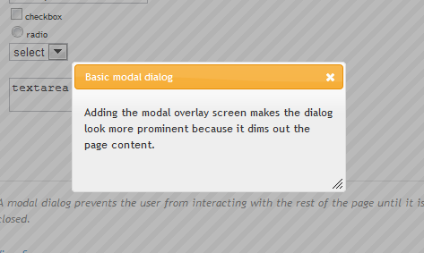
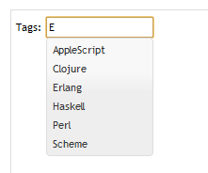
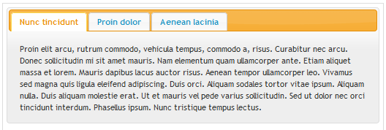
Canonical Example: jQuery UI

Slide 12
Popular in the Community
Interaction
Cycle – slideshows…
Hover Intent – sophisticated hovering
Table Sorter – spiff up tables
Utility
Back Button & Query Library (BBQ)
Cookie

Slide 13
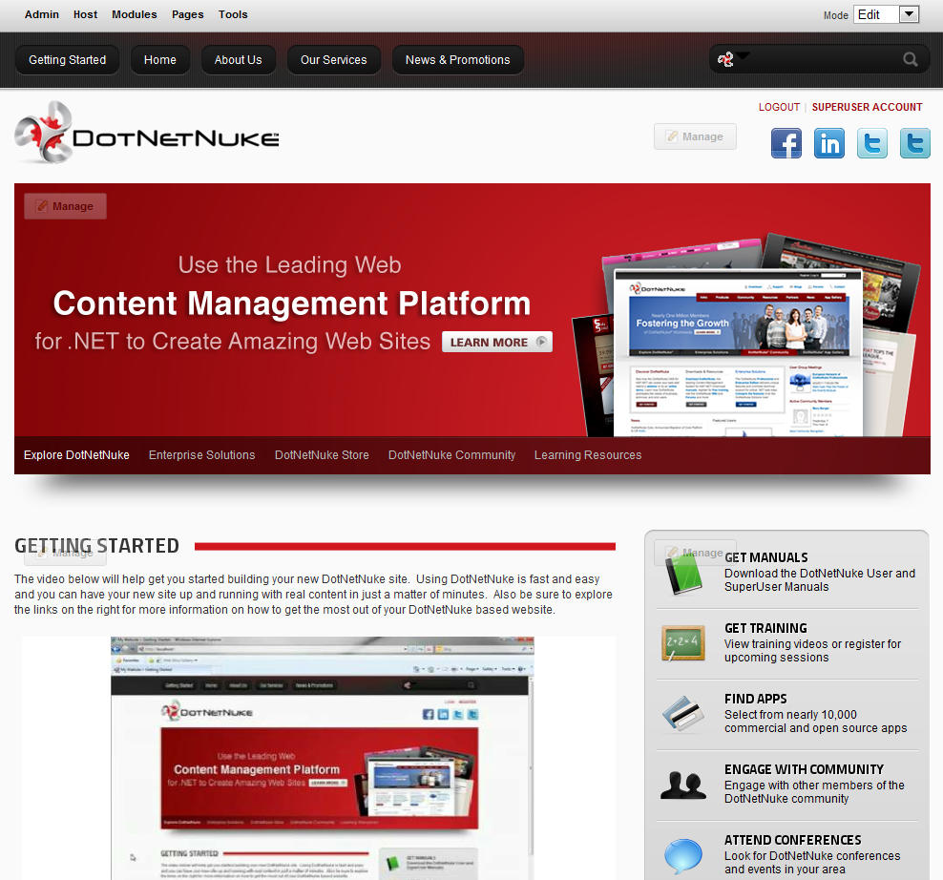
[Case Study]

Slide 14
Goals
Updated, modern, user interface
Consistent user experience
Ease of implementation
Reuse by third party developers

Slide 15
[Demo]

Slide 16
Demo Review
Collection of plugins (UI widgets)
Use smart defaults
Based on established HTML Conventions
Public API used for configuration as needed
Generally very simple to consume

Slide 17
[Creation]

Slide 18
Creating a Plugin
Wrap business logic with plugin logic
Logic can stay largely the same
Modify to inject settings and context
Modify for safety and to play well with others

Slide 19
First things first
Always wrap in a closure
(function($){
// ahhh…safety
})(jQuery);

Slide 20
Define Your Plugin
No selecting needed
$.myPlugin = function(options){…};
Select and return (chain)
$.fn.myPlugin = function(options){
return this.each(function(){
… });
};

Slide 21
Establish Default Options
$.fn.myPlugin.defaultOptions = {
speed: ‘slow’
};
var opts = $.extend({}, $.fn.myPlugin.defaultOptions, options),

Slide 22
Inject HTML Context
Options aren’t just for “settings”
Inject all context through options
$(‘.nav’).myPlugin({
speed: ‘fast’
subNavSelector: ‘li.subnav’,
});

Slide 23
Events
Sure you need to enforce doc ready?
If you’re ever unbinding events, bind them with a namespace first.
Favor this:
$(‘elem’).unbind(‘click.Namespace’, function(){…});
Instead of this:
$(‘elem’).unbind(‘click’, function(){…});

Slide 24
[Code Demo]

Slide 25
Ian Robinson
Session Feedback: http://bit.ly/jqstldodn
Twitter @irobinson
GitHub http://github.com/irobinson
StackOverflow Careers http://bit.ly/irobinson
jQuery Crash Course
http://jquery.ian-robinson.com

Slide 26
References
http://nathansjslessons.appspot.com
http://api.jquery.com
http://benalman.com
http://msdn.microsoft.com/en-us/scriptjunkie
http://marcgrabanski.com/articles/jquery-plugins-toolbox
http://www.dotnetnuke.com/Resources/Wiki/Page/Reusable-DotNetNuke-jQuery-Plugins.aspx

